Slide 1
The Virus Narrative vs the EMF Narrative.
Presentation of research and findings by Anders Brunstad in 2023.
Updated and edited on 3th of June, 2023.
I have conducted research into the COVID-19 pandemic for almost 3 years, done my own observations, and developed my own empirical research on all-cause excess mortality, first for 2020, then in early 2021, initially all-cause mortality only for 2020.
then for 2015–2022, during the last 5 months of 2023, with a focus first on Norway, my home country, the USA, Switzerland, and Canada, to explore differences in mortality linked to differences in EMF exposure in an 8-year time line with different EMF frequencies (USA up to 26–38 GHZ) and differences in EMF regulations (Swiss, Canada, USA/EU).
And I linked my own empirical research to some peer-reviewed research by a Norwegian team (Long Covid), a USA team for EMF 4G/5G led by Dr Beverly Rubik, and a Canadian team led by Dr Magda Havas (5G), and some of the most important US studies on how the "Covid19 Jabs", caused a weaker immune system (ref. the Cleveland Study), which in turn caused a massive increase in „Covid19” and all-cause mortality, across the world.

Slide 2


BIO and CV of Anders Brunstad, born in Ålesund in the year of our Lord, 1966.
I was born into a Christian family and grew up on a small dairy farm in Brunstad, Sykkylven, close to Aalesund, Norway.
My father was the local Sunday school teacher. I enjoyed life and played football, competed in alpine skiing, and played trumpet in three different orchestras. And I was a sheep shepard and a grouse and deer hunter, fishing trout and salmon, like my close family and local friends at the time. I was in the first gymasium class learning computer programming and had summer jobs making computer calculation models.
I went to the Army services in 1985 and got a special assignment of training the Army HQ in Oslo after passing an exam to make a program filling out "lotto cupongs" for the top brass by random numbers.
and got to work on training the Plan & Budget Department on how to use the Spreadsheet Multiplan to make the defense budget in the spring of 1986, while studying for Exam Philosoficum, Science, and Logic at the University of Oslo in the evening.

Slide 3

BIO and CV of Anders Brunstad, born in Ålesund in the year of our Lord, 1966.
I went on to the Norwegian State Business School of NHH in Bergen for four years in 1987 and had a year of consulting at DRT in Oslo before I started my own furniture business and a Polish factory from scratch in late 1991. I have now been an independent businessman for 32 years. I was hit by the massive abuse of COVID-19 travel and business restrictions. My own business crashed in late 2020. The „Sars-Cov2 virus” killed millions of businesses due to the insane COVID-19 policies.
I realized that I was among the first to use spreadsheets as analytical tools, that I have been using them for 40 years, and that I have a bit more than average Excel skills, plus a higher education in statistics from NHH. Based on my own COVID-19 research for 2 years, I went into my own empirical research.
First for Norway, then the USA, Switzerland, and finally Canada.

Slide 4
Part 1; Norway is documented in a separate, huge PowerPoint presentation.
Due to the enormity excess mortality in Norway in the 2nd half of 2021, and 2022, I started first in early 2021 to study 2020 mortality, and much later, in January 2023, to make an all-cause study, and found that the vaccine narrative could not explain all of what was going on. I quickly realized there was a huge difference between cities and the countryside, and set up a rather large statistical analysis to look into the main cities, and smaller cities with more than 40 smaller municipalities as the Control Group. I had made extensive research for 2-3 years, but did not see the 5G connection before it, as the missing link to understanding what was going on. So I researched it extensively.

Slide 5
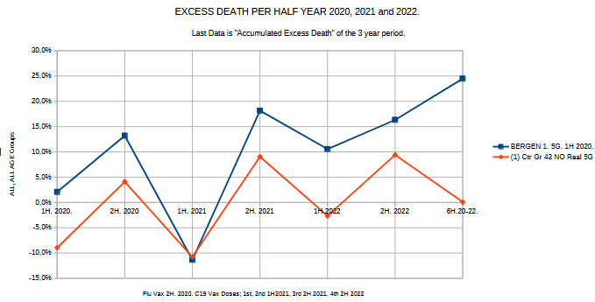
Bergen, the 2nd largest city of Norway, launched 5G on 13.3.2020 vs. NOT launched in the control group of 43 smaller municipalities in rural Norway. ALL-AGE GROUP

Slide 6
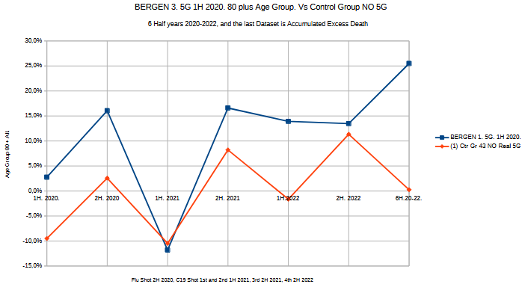
Bergen, the 2nd largest city of Norway, launched 5G on 13.3.2020 vs. NOT launched in the control group of 43 smaller municipalities in rural Norway. FOR THE 80 PLUS AGE GROUP

Slide 7
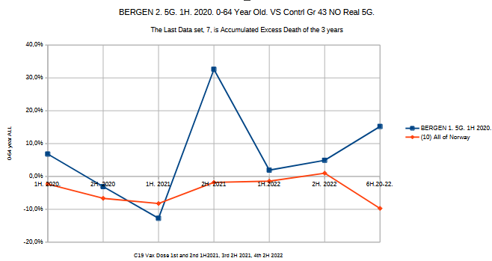
Bergen, the 2nd largest city of Norway, launched 5G on 13.3.2020 vs. NOT launched in the control group of 43 smaller municipalities in rural Norway. FOR THE 0-64 AGE GROUP

Slide 8
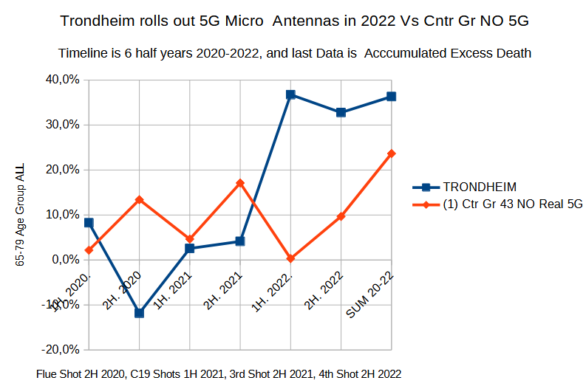
Trondheim, the 3rd largest City of Norway, got 5G 13.3.2020, and 5G Microcelle Antennas during 2022. Vs NOT at the Control Group of 43 smaller rural municipalities with a much larger total population.
The Age Group 65-79, was hit much harder than the 80 Plus.

Slide 9
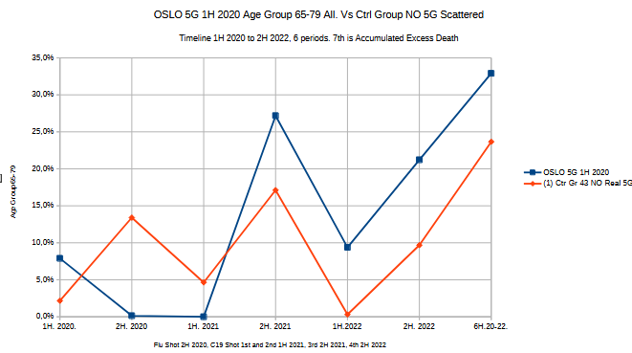
OSLO, the largest city of Norway, launched 5G on 13.3.2020 vs. NOT launched in the control group of 43 smaller municipalities in rural Norway. AGE GROUP 65-79. Vs Control Group. 5G Microcell Antennas coming gradually. The end point; ca 10% higher excess mortality in Oslo.

Slide 10
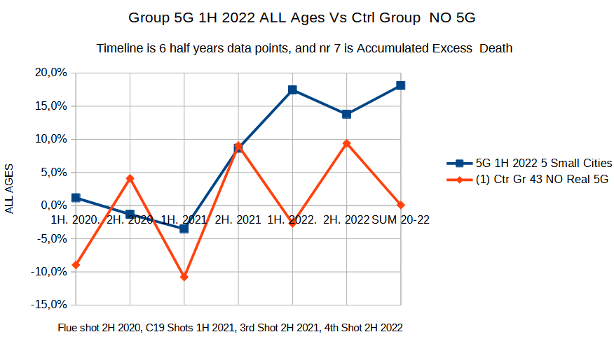
Municipalities which got 5G 1H 2022, vs Control Group Not. All Age Group.

Slide 11
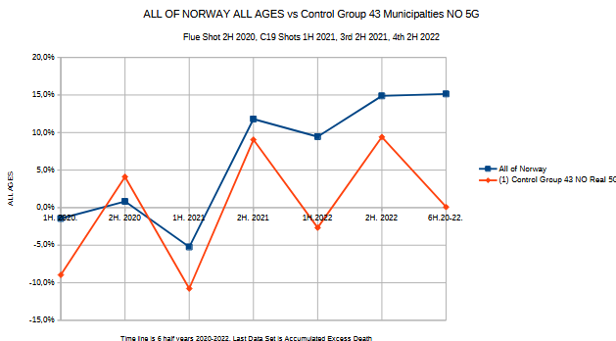
ALL OF Norway, big Cities launch 5G on 13.3.2020 vs. NOT launched in the control group of 43 smaller municipalities in rural Norway.
ALL-AGE GROUP. Norway; 15% vs Zero Excess Mortality in Control Group.

Slide 12
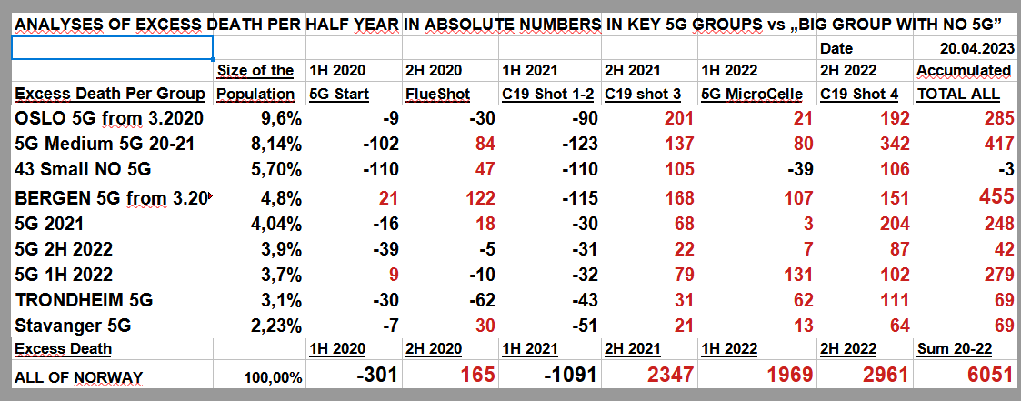
NORWAY. Final Total Analyses of Excess Absolute Death Numbers in each of the Groups. All Age Group.
6051 excess death, vs Zero in The Control Group.

Slide 13
Conclusion of findings from Norway: 1) The "Sars-Cov2 or Virus Narrative" is not supported. There is no excess mortality in the 80+ age group in rural Norway.
2) The 5G hypothesis is consistent with findings in all the data sets.
1. No total excess mortality in Control Group No. 5G during the 3-year period All Ages. 80+ or 0,64 age groups
2. No excess death for 80+ late 5G groups
3. 15% excess mortality for all of Norway over a 3-year period
4. 25% total excess mortality in Bergen, all ages, during a 3-year period And 15% excess mortality in the 0-64 age group. And 25% excess mortality in Bergen at 80+.
5. 35% excess mortality in the 65–79 age group in Oslo and Trondheim vs. 25% in the control group
6. A rather big negative mortality rate of 0.64 for most groups, except for Bergen.
7. Bergen got 60% higher absolute excess mortality numbers than Oslo, which has more than double the population. Bergen is a much smaller and more compact city.
8. The largest excess mortality age group is 65–79. But higher by almost 50% in 5G groups. This age group shows two likely sources of excess mortality:
Covid19 Shot nr 3 second half of 2021 and Shot nr in the second half of 2022. (ref. The Cleveland Study).
The 5G Connection
Claim The 65-79 age group uses more 4G/5G than the 80+ age group, which uses the phone more for talk and text.

Slide 14
Part 2: The USA is documented in a separate, huge PowerPoint presentation.
Knowing what I found in Norway, I defined 5 metro states of the USA as the „5G Proxy”, and 6 smaller states as the „Control Group NO 5G Proxy”.
I set up data models and made groups for METRO States and Rural States, as well as a special for New York State, which consists of All of New York States, New York City, and the Difference is Upstate Rural New York State.
There is a significant difference in excess mortality in rural states and upstate New York vs. New York City and metro states with big cities.
The 5 metro states are included in this analysis: New York State, New Jersey, Illinois, Maryland, and Massachusetts.
The six rural states are Maine, Montana, Nebraska, New Hampshire, South Dakota, and Vermont.

Slide 15
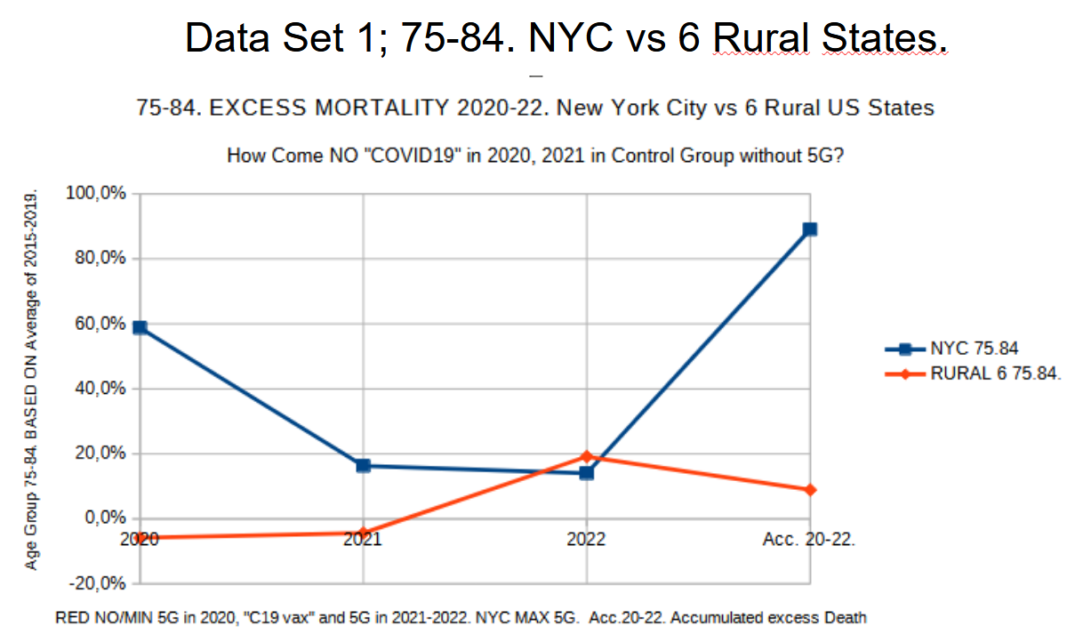
Data Set 1: No excess deaths in rural six states in 2020 or 2021 in the 75-84 age group.
How can this be consistent with the COVID-19 virus narrative?

Slide 16
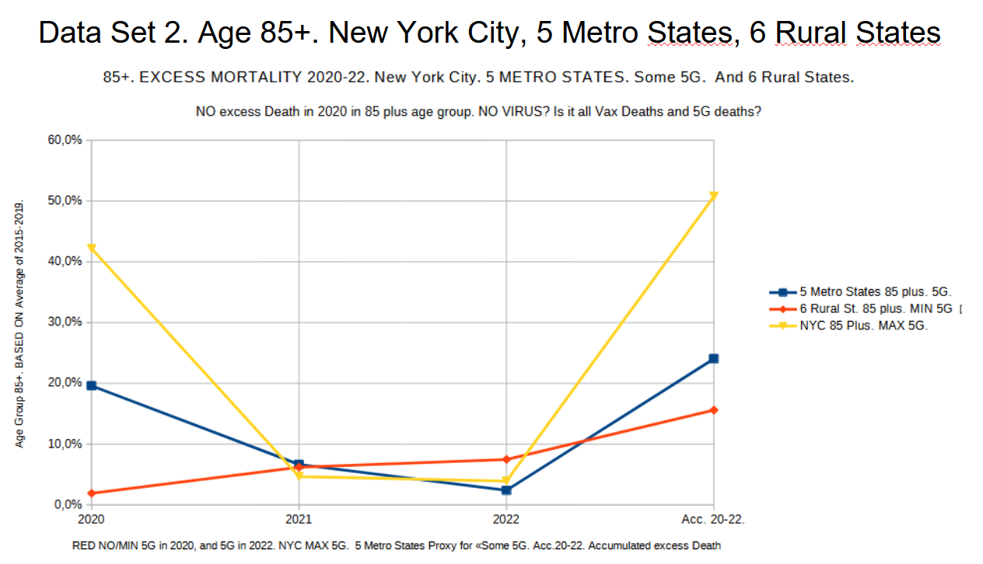
Data Set 2: No excess deaths in six rural states for people aged 85 or older in 2020, and very small excess deaths in 2021 and 2022, despite experimental jab vaccination policies.
There is a huge excess of death in New York City and less in the metro states in this age group.
New York City got real 5G early in 2020.

Slide 17
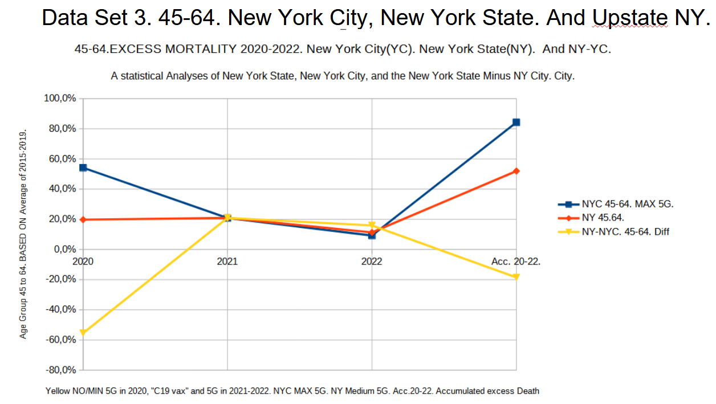
Data Set 3: In Upstate New York, the age group 45–64 had no total excess mortality in the 2020–2022 period. However, the citizens of New York City had an excess mortality rate of 80% in this period, starting with almost 50% in 2020 when the 5G network was switched on.

Slide 18
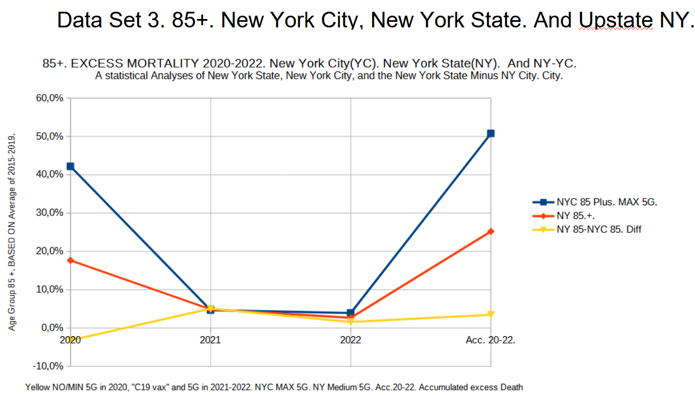
In Upstate New York, the 85+ population had close to zero excess mortality in 2020–2022, whereas in New York City it was about 50%.

Slide 19
Conclusion of findings from The USA: 1) The "Sars-Cov2 or Virus Narrative" is not supported. There is no excess mortality in the 80+ age group in rural USA.
2) The EMF/ 5G hypothesis is consistent with findings in all the data sets.
1. No total excess mortality in Control Group of 6 Rural States for 85+ of Age in 2020, and less then 5% Excess Mortality of the 3 year periode of 2020, 2021, and 2022 in New York Upstate.
2. No total excess mortality in Control Group of 6 Rural States for 75 - 84 of Age in 2020, and 2021.
3. No total excess mortality in Control Group Upstate New York in 45-64 in 2020, 2021 and 2022 total.
4. NYC with 60% Excess Mortality in 75-84 in 2020 and 90% over the 3 year periode.
5. NYC with 43% Excess Mortality in 85+ in 2020 and 52% over the 3 year periode.
6. NYC with 55% Excess Mortality in 45-64 in 2020 and 85% over the 3 year periode.
7. US 5 Metro States with 20% Excess Mortality in 85+ in 2020 vs 3% of US Rural 6 States.
US used up to 26-38 Ghz and 10 Watt/m2 of radiation at the launch of 5G.
Compared to 2-4 Ghz in Canada and 3,4 Watt / m2 in Canada. And 0,1 Watt/m2 in Swiss.

Slide 20
Part 3; Switzerland is documented in a separate, huge PowerPoint presentation.
Before I started to analyze Switzerland, I did some research and found that they had started to build out 5G as early as 2018, but launched it in March 2020.
Swisscom claimed that they had 80–90% coverage early on, so I decided to look at all of Switzerland as one area.
What is special about Switzerland is that they have very strict EMF regulations, allowing for only 0,1 Watt/m2, compared to 10 Watt/m2 in the USA, the EU, and Norway.
Further, Swiss regulators allowed EMF frequencies up to 4 GHz, vs. up to 38 GHz in the USA.
What consequences will such a difference have on all causes of mortality and on different age groups? Compared to the USA, Norway, and Canada?
When comparing to the USA with 26–38 GHz and up to 10 Watts/m2, and Canada with up to 3.4 Watts/m2?
And Norway with a rather huge rural population actually mainly covered by 4G and 4G plus Macro Antennas of 600-2500 mhz? And not so much MicroWave 5G except the bigger cities?

Slide 21
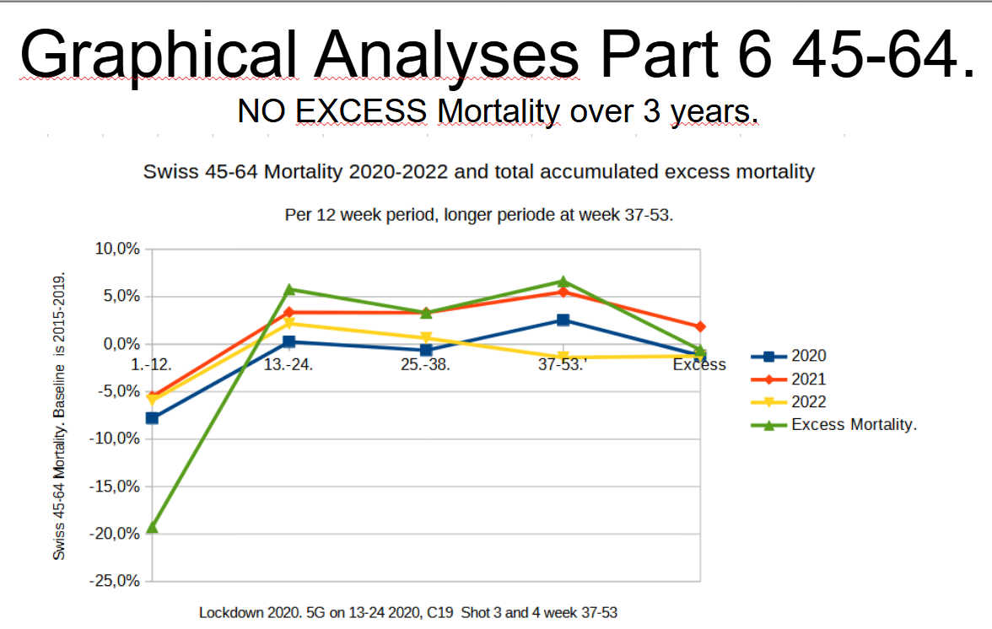
NO EXCESS MORTALITY IN SWITZERLAND IN 45-64.
Link to 0,1 Watt/m2. ZERO Excess Mortality 2020-2022.

Slide 22
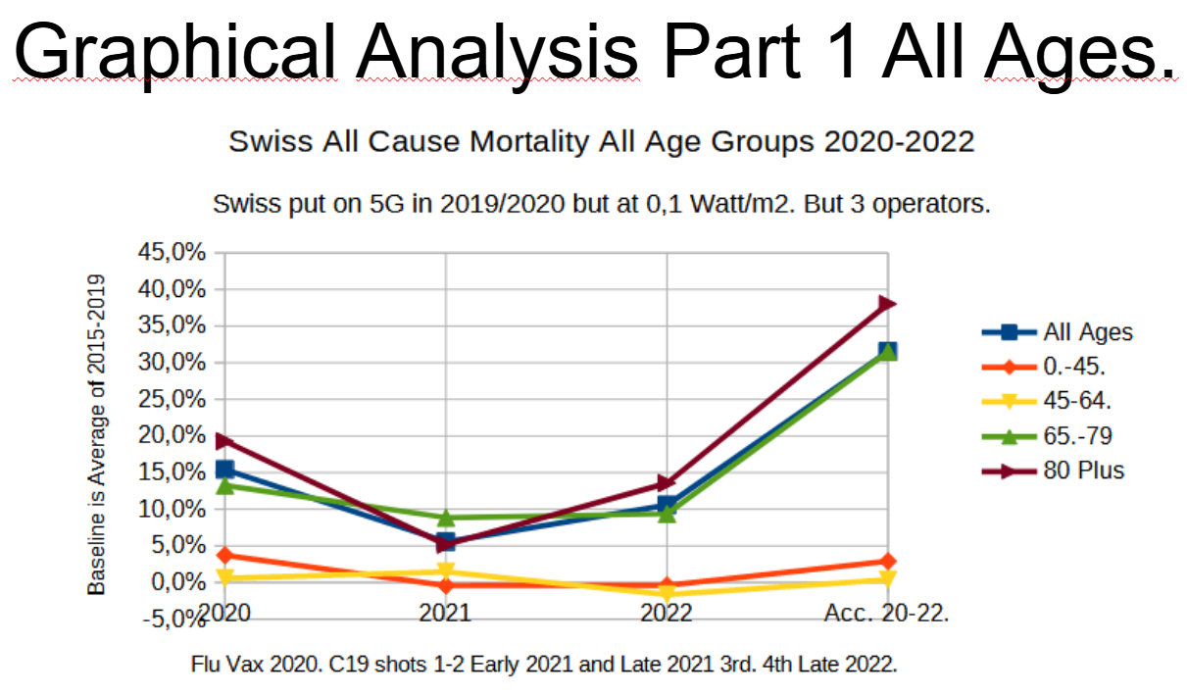
Swiss Excess Mortality 2020–2022. Per Age Group.
1. Between 30–35% total excess mortality in the 65–79 and 80+ age groups
2. Approx. 3% excess mortality in the 0-45 age group, highest in 2020.
3. Approx. 1-2% excess mortality in the 45-64 age group, highest in 2021.

Slide 23
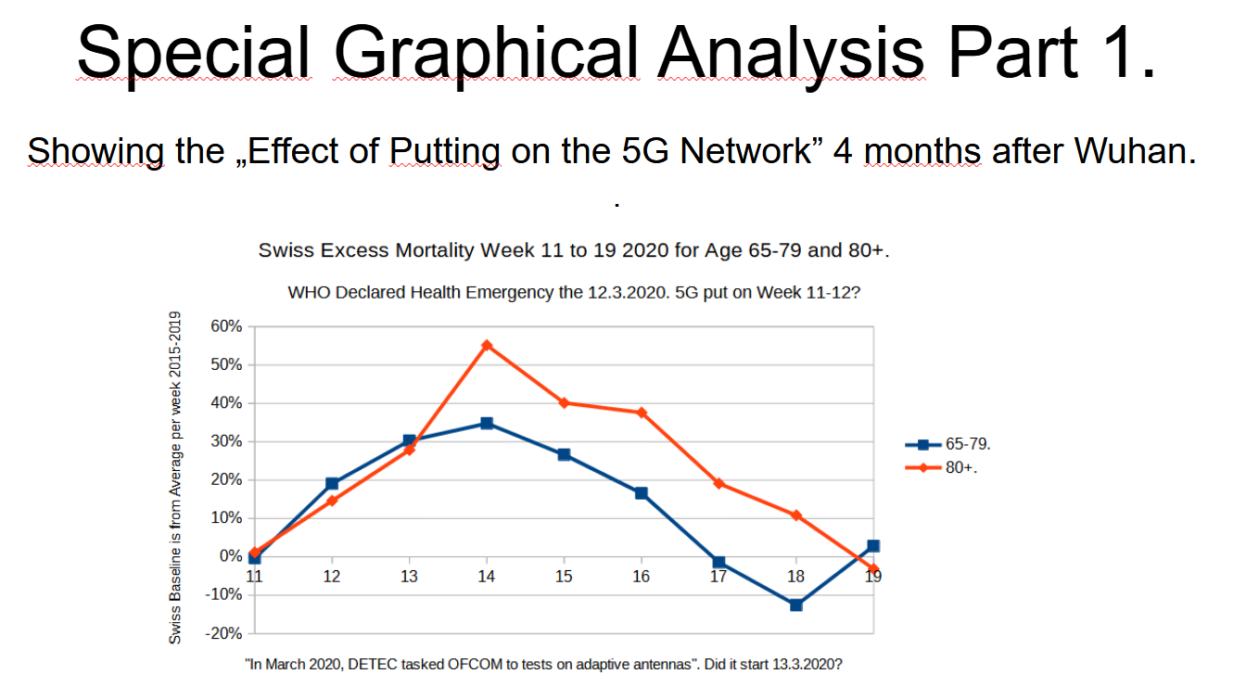
In March 2020, DETEC taskekd OFCOM to tests on adaptive Antennas. Meaning 5G.

Slide 24
SPECIAL ANALYSIS FOR SWISS FOR SOME IRREGULARITIES
Based on the baseline data for 2015–2019, to establish the historical weekly average death per age group, I came across something that happened in 2015, at the time Swiss launched the 4G LTE Advanced. The data speaks for itself.
These data suggest clearly that even the 0,1 Watt/m2 of the Swiss regulations may not be strict enough to avoid excess mortality caused by EMF radiation like the 4G level of 2015, even for the 0-45 and 45-64 years age groups.

Slide 25
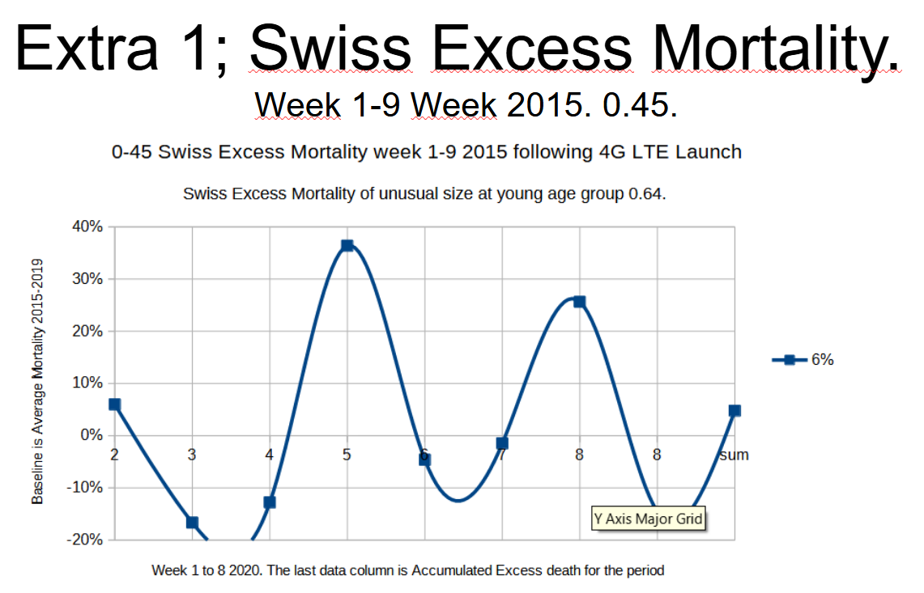
Switzerland; Special analysis of what happened in 2015?

Slide 26
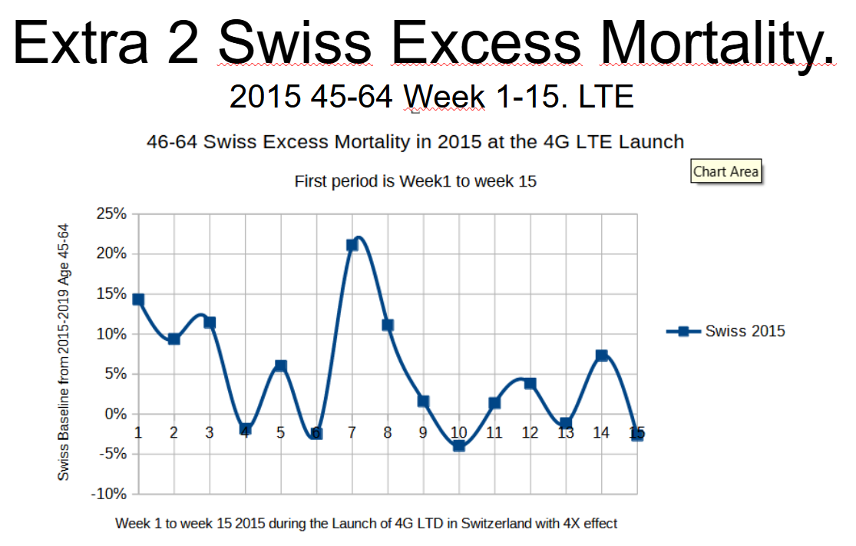
Switzerland; Special analysis of what happened in 2015?

Slide 27
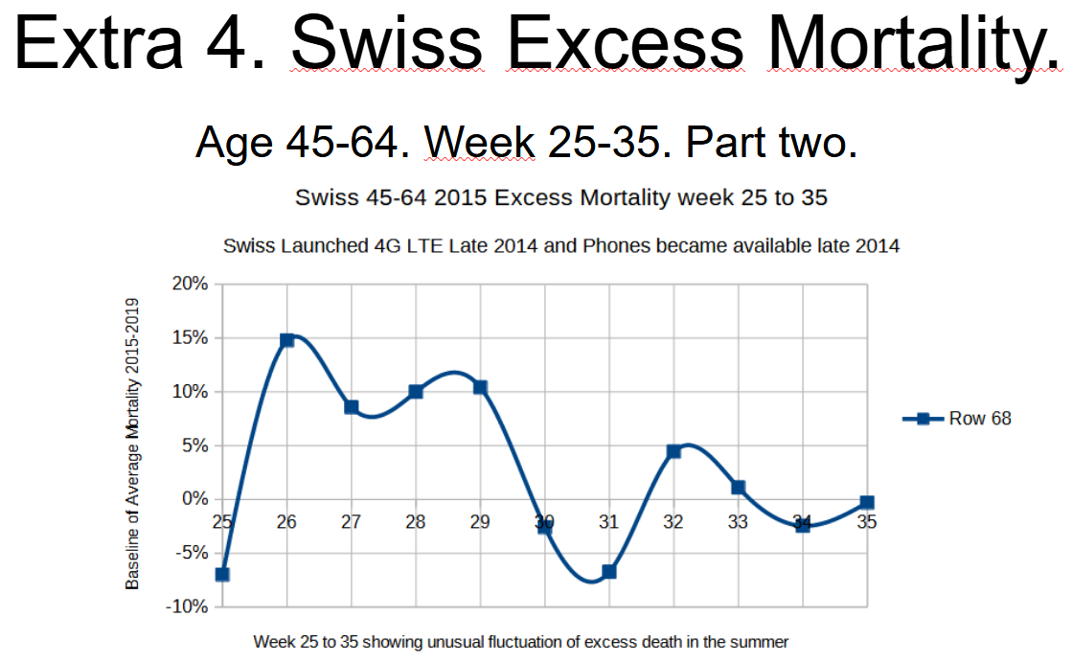
Switzerland; Special analysis of what happened in 2015?

Slide 28
Switzerland; Special analysis of what happened in 2015?

Slide 29
Conclusion of findings from Switzerland
1) The EMF/5G hypothesis is consistent with the findings in all the data sets.
2) But with a very different pattern than in the USA and Norway due to the wide coverage of 4G+/5G.
1. "All of Switzerland" got 4G Plus/5G in 2020, or at least 85–90%. Related to a sudden big increase in excess mortality.
2. The excess mortality was highest in 80+, with approx. 20% in 2020, much less in 2021, and up in 2022, and 38% over 3 years.
3. The 65-79 age group by about 13% in 2020 and about 30% in total over the 3-year period, less in 2021, and higher in 2022. (Spred out)
4. Close to zero excess deaths in the 45–64 age group
5. And approx. Only 3% in the age group of 0.44.
6. Swiss regulation limits it to 0.1 Watt/m2 and less than 4 GHz of frequencies so far.
7. The US used up to 26–38 GHz and 10 watts/m2 of radiation at the launch of 5G. And had 2x higher excess mortality in 65 and up.
8. And a big mortality rate in 45–64
9. But only mainly in 5G metro states and 5G cities.
10. And much less in rural states.
11. In the USA, there is a sudden big increase in 5G cities and metro states, while in Switzerland it is more gradual per year.
12. Data from 2015 shows that the 4G LTE launch also correlated to excess mortality, but not so much.

Slide 30
Part 4; Canada is documented in a separate, huge PowerPoint presentation.
The most interesting scientific discovery of my life was made this week when I analyzed all -cause mortality study in Canada for 2020 in the Metro Provinces with 5G launched at different time periods.
The fact that the waves of excess death is 100% correlated to the 5G rollout I found by researching the launch program the day after I made the statistical analyses.
I documented it and put it into slides in a PowerPoint presentation.
The COVID19 or the virus narrative struggles with the fact that the Age group of 85 plus in rural Canada had zero excess mortality during the 2020 COVID19 pandemic.

Slide 31
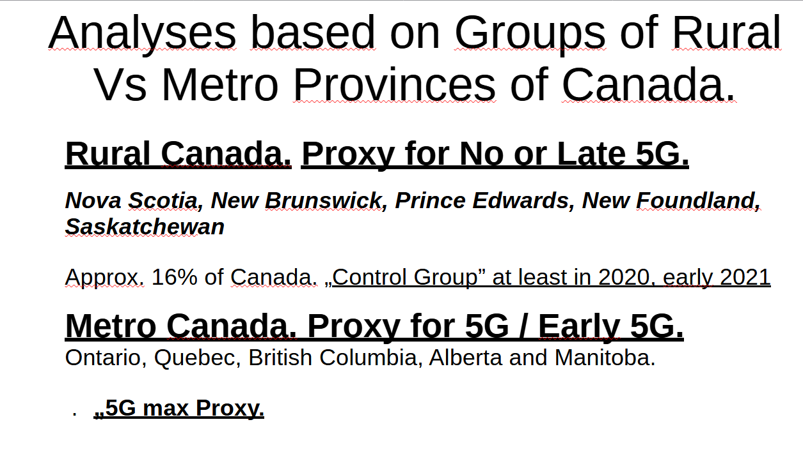
The METRO Provinces vs the RURAL Provinces of Canada.

Slide 32
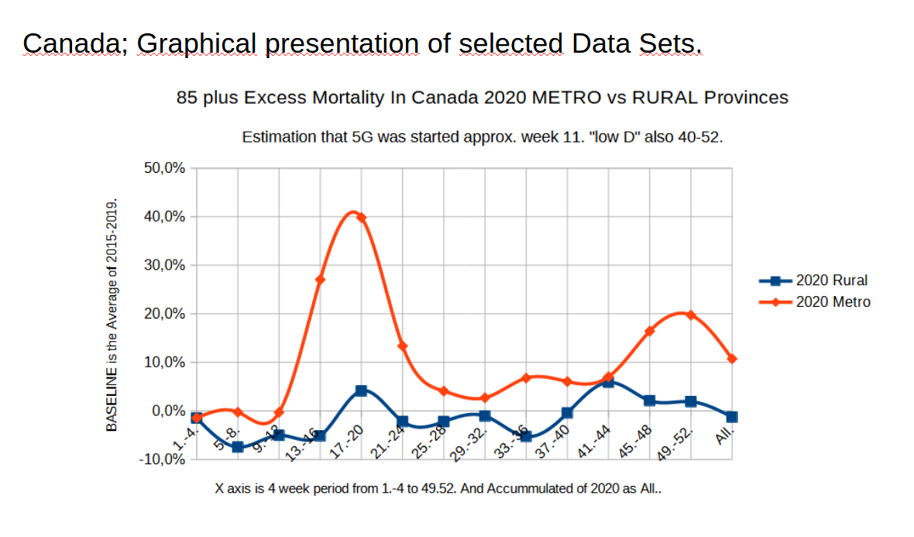
The COVID19 or the virus narrative struggles with the fact that the Age group of 85 plus in rural Canada had zero excess mortality during the 2020 COVID19 pandemic.

Slide 33
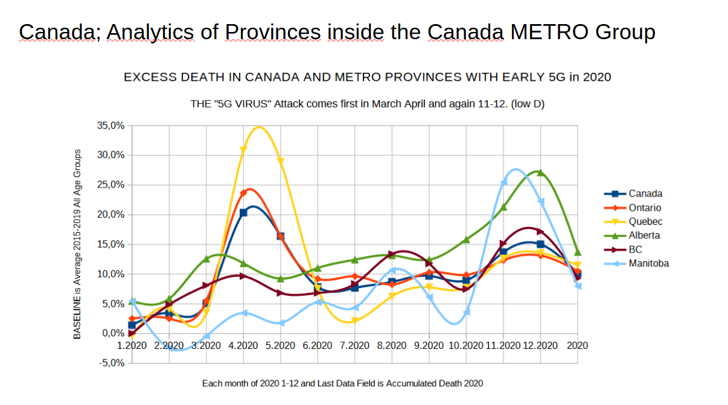
It is very interesting to see the components of the excess mortality linked to the Metro Provinces of Canada and that each of the tops is related to a prior 5G launch - very close and in 100% correlation.

Slide 34
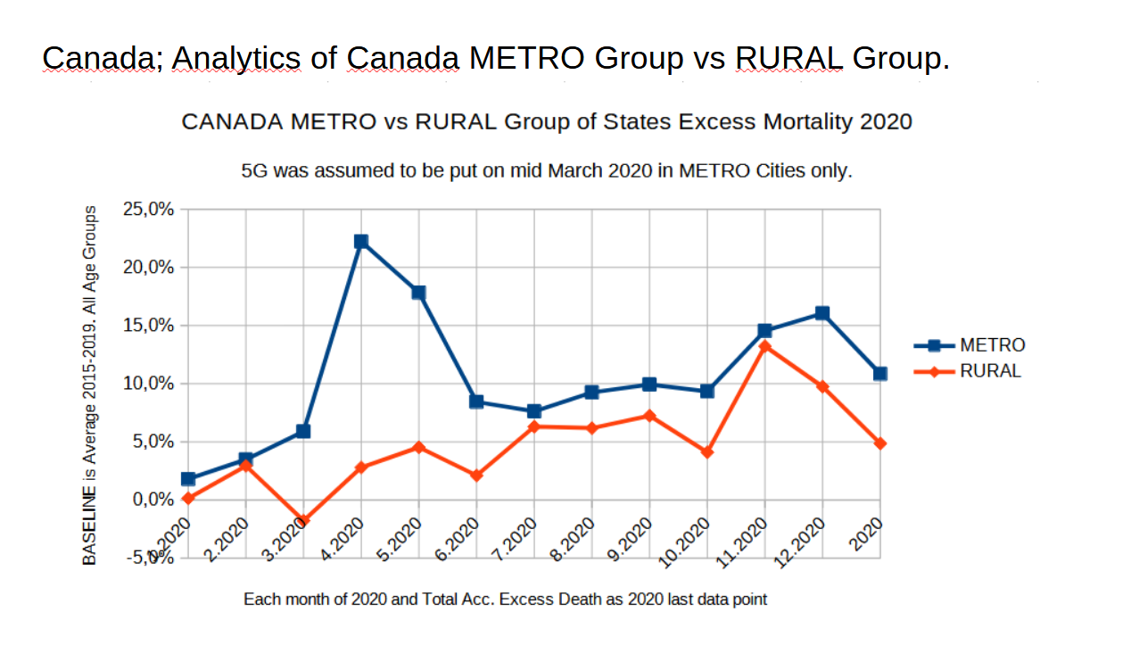
It is very interesting to see the METRO excess mortality Per Month compared to the Rural Provinces.
The METRO has approx. 10% excess Mortality in All Ages in 2020 vs 5% of the Rural provinces.
Who may have got 5G / 4G Plus later during the summer and autumn of 2020.

Slide 35
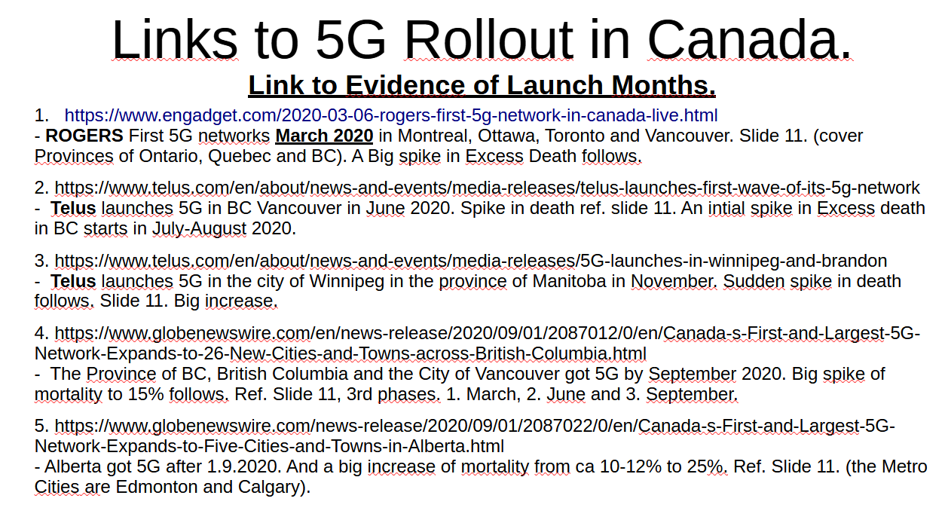
BINGO; The Timeline of 5G launch matches the Timeline of the Excess Mortality almost 100%. The documtation of this is in below hyperlinks

Slide 36
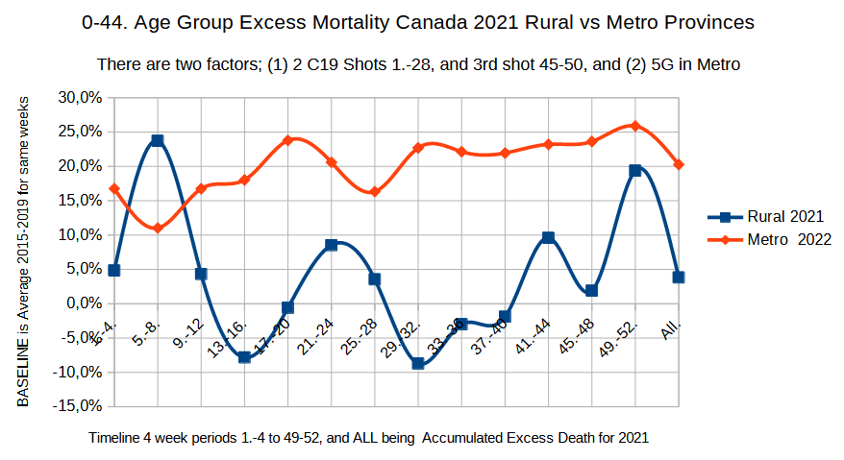
Canada; Metro provinces vs Rural. Timeline and Age Groups analysis.
Age 0-44. 2020-2021.The Rural Provinces; less 15% excess Mortality

Slide 37
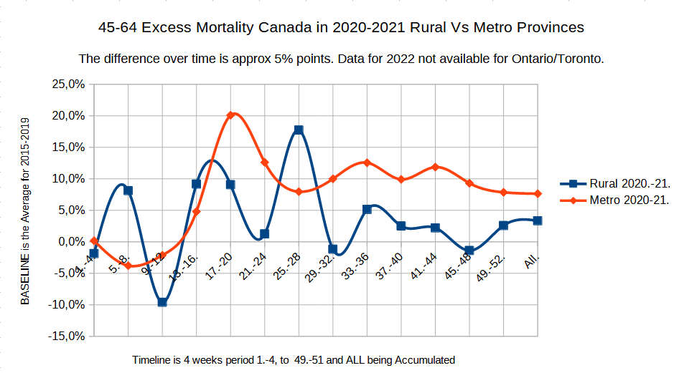
Canada; Metro provinces vs Rural. 2020-2021 and Age Group 45-64.

Slide 38
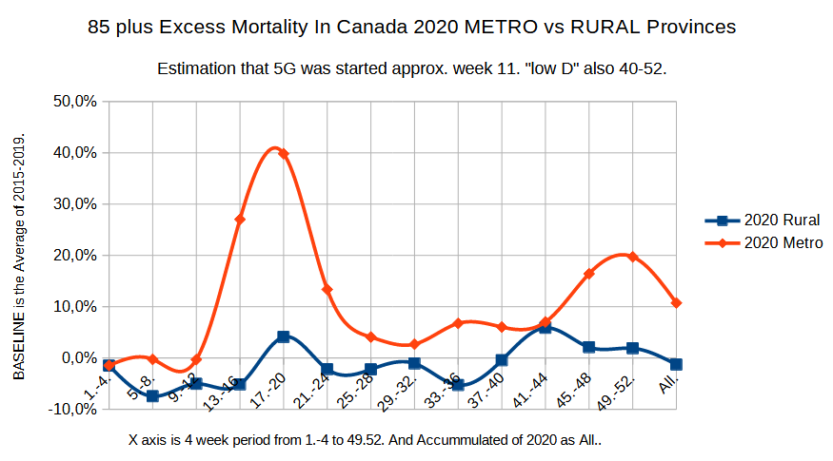
Canada; Metro provinces vs Rural. Timeline and Age Groups analysis.
Age 85 plus. 2020-2021.The Rural Provinces; less 10% excess Mortality.
Zero Excess Mortality in 85 Plus in 2020. No Virus?

Slide 39
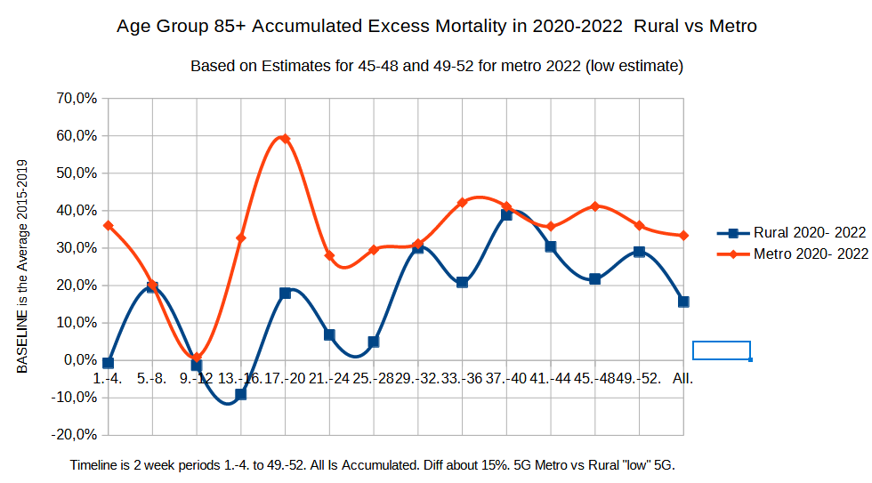
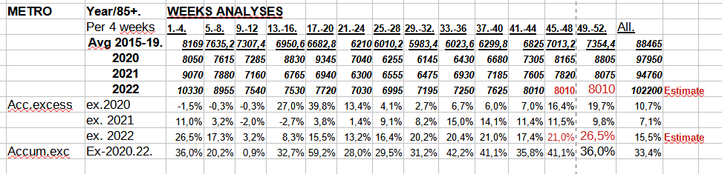
Canada; Metro provinces vs Rural. Timeline and Age Groups analysis. With estimates for last 6 weeks of Ontaria, due to missing real data from Ontario for last part of 2022 (!!)..
Less then 50% Excess Mortality in Rural Provinces then Metro Provinces of 3 years.

Slide 40
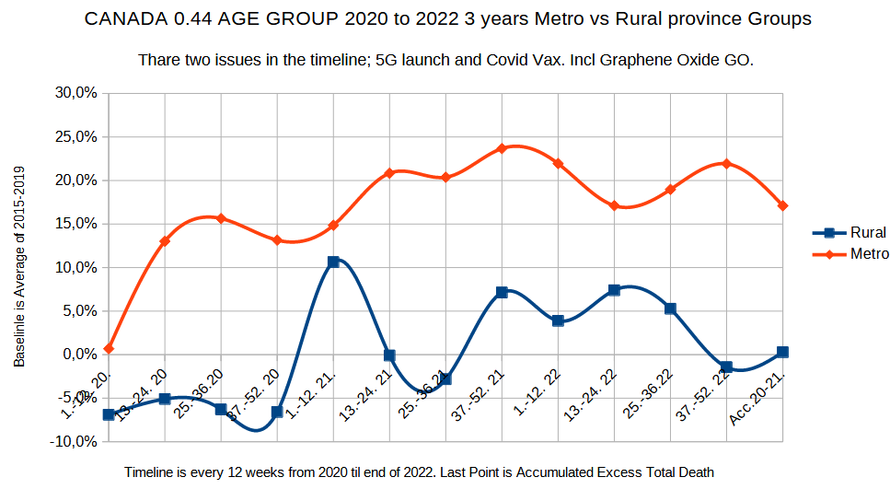
Canada 12 week timeline analyses. Age Group 0.44. Metro vs Rural.
End Result; Approx. Zero Excess Mortality in Rural vs 17% in Metro.
From 1st Quarter of 2020 till 4th Quarter of 2022. + Accumulated all of it.
The Rural top 1; C19 shot 1-2, Blue top 2; C19 Shot 3. Approx. the same in „Metro”

Slide 41
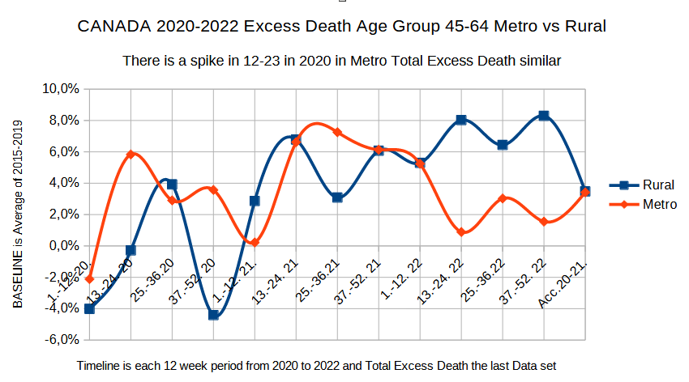
Canada 12 week timeline analyses. 2020-22. Age Group 45-64. Metro vs Rural.
End Result; Approx. 4% Excess Mortality in both Rural and Metro. However, Metro got „all of it in 2020-21”, Rural much of it late. sThis can be related to the later timeline of the rollout of 4G plus and 5G Rural. Spcial comments; Rural top 1; „link to C19 Shot 1-2”, Top 2; Link to C19 shot 3, Last top of Rural; Link to C19 shot nr 4.

Slide 42
Canada Special Analysis. Part 5; ROTTEN EGGS IN THE BASELINE
During the work to establish the baseline for historical average monthly and annual mortality for Canada for the years 2015-2019, I came across some rotten eggs.
I could see a huge spike in excess deaths in 2018, which were totally out of the historical standard deviation.
I noticed it, but it did not distract from my 100% focus on the task of establishing the baseline, in order to compare the baseline with the months of 2020, as totals and for each of the Canadian statistical provinces.
But after finishing that main task, I revisited the 2018 data set, and made a 2 year analysis to find when it started and ended. By presenting the data in a two-year, 2 x 12 month timeline.
And aggregate this into 4x3 months per year for a timeline of 8 data points. See the result.

Slide 43
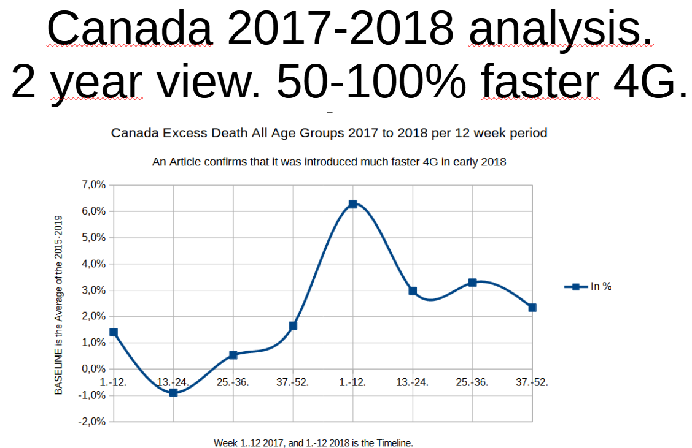
Part 5; ROTTEN EGGS IN THE BASELINE

Slide 44
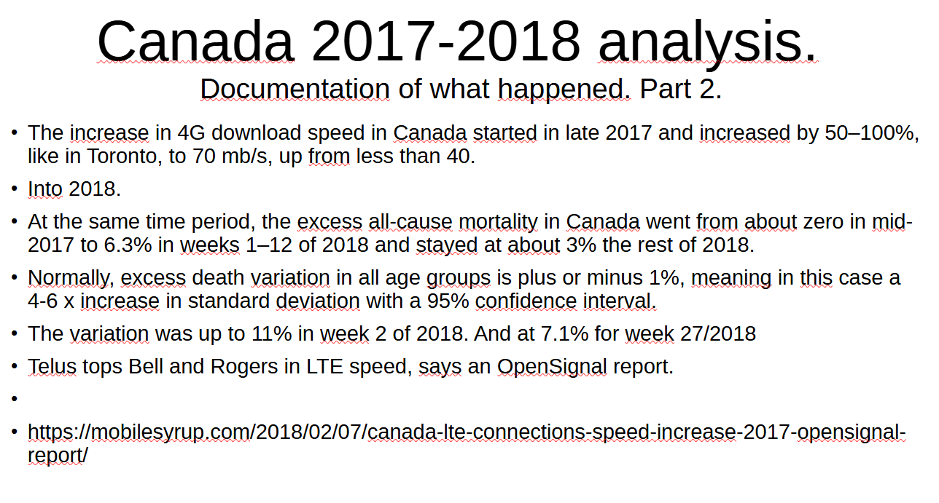
Then I had to do research to see if I could identify any EMF or 4G event correlated to this huge increase in excess mortality of up to 6- 10 x standard deviation. Which never happened in recent history. And wow!!
I found a link to the fact that Telus, one of the main operators ugraded their 4G network late in 2017 with higher frequencies and more output, resulting in a 50 - 100% speed increase. Just before the spike in excess mortality.

Slide 45
Conclusion of findings from Canada, the USA, Switzerland, and Norway
1) The EMF/5G hypothesis is consistent with the findings in all the data sets.
2) but with a very different pattern than in the USA and Switzerland. 3) Norway is different.
1. Canada's 0-44 age group in rural areas has approx. Zero excess mortality in the 2020–2022 three-year period vs. 17% in 5G metro provinces.
2. Canada's 85+ age group had a surge in excess mortality as the 5G was launched in March, and it was increasing in provinces as the 5G was launched during 2020, whereas the rural 85+ age group had ZERO excess mortality in 2020, not consistent with the Virus Narrative.
It is a perfect correlation of excess mortality in metro states as 5G was rolled out in province after province.
3. Canada: The end point for 2022 in 85 plus, based on some conservative estimates, is that there was about 50% excess mortality in rural vs. metro provinces, of 33% vs. 13%.
Discussion;
This is very similar to the Swiss mortality level of 35% in Metro Canada. Over a 3-year period.
It is much lower than the excess mortality rate in the United States for people aged 80 and up.
The USA had two different EMF parameters: 26–38 GHz frequencies vs. less than 4% in Canada and Switzerland.
whereas the USA had 10 Watt/m2 vs. 3,4 Watt/m2 in Canada and 0,1 Watt/m2 in Switzerland. The US combination of microwave frequencies of up to 38 GHz and up to 10 watts/m2 clearly correlates to the highest excess mortality of these four countries.
The Swiss regulations of 0,1 Watt/m2 correlate to the much lower excess mortality in all age groups less than 65 years.
There are science papers confirming that EMF, 5G, and 4G cause damage to the immune system, and if that is combined with the age group of 65 and up with a natural reduction of immunity linked to low D vitamin and the "Vax Effect," ref. From the Cleveland Reports, in particular from the 3rd C19 shot, the picture becomes clear. The "glass is full" and the risks are at their maximum.
4. In the 45-65 age group, there is about 5% higher excess mortality at the end point in metro vs. rural provinces (8% vs. 3%).
5. The Norwegian mortality data only started to "explode" in Bergen and Trondheim during 2022 as they launched real 5G microcell antennas, as the early launch primarily was the macro antennas of 4G plus rebranded as 5G base. The result is a higher mortality rate up to the level of Canada and Switzerland of 35% mortality in the 65–79 age group and a real increase also in younger age groups.

Slide 46
A short list of the most related litterature;
1. Beverly Rubik et al. Sept 2021, and 1998.
https://www.ncbi.nlm.nih.gov/pmc/articles/PMC8580522/ and „Evidence for a connection between coronavirus disease-19 and exposure to radiofrequency radiation from wireless communications including 5G”. And a presentation from late March 2023.
2. Magda Havas and Angela Tsiang.
https://magdahavas.com/5g-and-mm-waves/is-there-an-association-between-covid-19-cases-deaths-and-5g-in-the-united-states/
Is there an association between covid-19 cases/deaths and 5G in the United States?
COVID-19 Attributed Cases and Deaths are Statistically Higher in States and Counties with 5th Generation Millimeter Wave Wireless Telecommunications in the United States.
Tsiang & Havas. Medical Research Archives vol 9 issue 4. April 2021
3. Havas in April 2023 to NCI of Canada. Sensored by Youtube.
https://rumble.com/v2kcqe6-5g-and-covid-symptoms-dr.-magda-havas-saskatoon-day-3-national-citizens-inq.html
4. . The Cleveland study.
https://www.medrxiv.org/content/10.1101/2022.12.17.22283625v1.full „ Effectiveness of the Coronavirus Disease 2019 (COVID-19) Bivalent Vaccine”.
5. Vyller et al. https://jamanetwork.com/journals/jamanetworkopen/fullarticle/2802893
Prevalence and Characteristics Associated With Post–COVID-19 Condition Among Nonhospitalized Adolescents and Young Adults
6. he Long Covid Study by a Norwegian Team. Prevalence of long COVID complaints in persons with and without COVID-19
https://www.nature.com/articles/s41598-023-32636-y

Slide 47
Empirical All Cause Excess Mortality Studies carried out by Anders Brunstad in April and May 2023 based on own research in 2020-2023;
1. The Norwegian all-cause excess mortality study linked to the time-line of the 5G launch.
English version 22.4. 2023. A Powerpoint Presentation with sources. And related Excel Data Models.
2. The USA all-cause excess mortality study linked to the time-line of the 5G launch.
8th of May 2023. A Powerpoint Presentation with sources. And related Excel Data Models.
3. The Swiss all-cause excess mortality study linked to the time-line of the 5G launch.
13th of May 2023. A Powerpoint Presentation with sources. And related Excel Data Models.
4. The Canadian all-cause excess mortality study linked to the time-line of the 5G launch.
24Th of May 2023. A Powerpoint Presentation with sources. And related Excel Data Models.
Summary Comparative study of the Excess Mortality studies of Norway, the USA, Switzerland and Canada.
2nd of June 20223. A Powerpoint Presentation with sources. And related Excel Data Models.

Slide 48
The History of the Virus Narrative. vs. the factual EMF events.
From 1889 until 2022.
After I concluded there was a clear correlation between the 5G launch in Norway and the excess mortality in Norway in 2020–2022, I started a study to find out if this was the first and only correlation to EMF launches or if I could find a pattern.
It took me a few weeks of study to get to the following total overview and another 4 weeks to find out that it was not complete and that I had missed at least one event.
However, as of today, June 3rd, I can say that it looks like it is the most comprehensive overview of the EMF events on written paper.

Slide 49
The History of the Virus Narrative. vs. the factual EMF events. From 1889 until 2022
Anders Brunstad, 8.5.2023. TO WHOM IT MAY CONCERN «A QUICK SUMMARY»
THE VIRUS NARRATIVE FOR 100 YEARS
The history of "viruses," which seem to have been actually created by historical EMF events;
Contrary to the "public narrative," which is supported by Big Pharma and "MSM,";
https://www.cdc.gov/flu/pandemic-resources/pandemic-timeline-1930-and-beyond.htm
1. The introduction of telegraph lines, Electricity. 1860–1890 (1889–1899)
"caused neurodepression diagnoses"
In 1889, the first "global virus" was linked to electrification following the patents of Tesla.

Slide 50
The History of the Virus Narrative. vs. the factual EMF events. From 1889 until 2022
In 1889, alternating current essentially was harnessed. It was invented by Nikola Tesla and his patents were adopted by Westinghouse and all of a sudden we could transmit electricity long distances with little loss of power. And this was harnessed extremely rapidly, so rapidly that we went from virtually zero use of alternating current, to intense use of alternating current in one year, and the year was 1889. 1889 was the year of the first great modern influenza epidemic and this went worldwide and it lasted four years and it killed a couple of million people.

Slide 51
The History of the Virus Narrative. vs. the factual EMF events. From 1889 until 2022
2. The introduction of Radio FM in 1918
As well as approximately 23 experimental vaccines by Rockefeller.
"The Spanish flu" and these "experimental vaccines"
caused 25–50 mill deaths.
(Many died of the experimental vaccines.)

Slide 52
The History of the Virus Narrative. vs. the factual EMF events. From 1889 until 2022
FM was first introduced by the US Army, and shortly after, civilian use of FM radio spread across the world.
https://www.metabunk.org/threads/claim-spanish-flu-caused-by-radio-waves.11188/
"In 1918, after the biggest pandemic, the Spanish flu pandemic of 1918, Rudolf Steiner was asked what all this was about. And he said, 'Well, viruses are simply excretions of a toxic cell. Viruses are pieces of DNA or RNA with a few other proteins they brought out of the cell. They happen when the cell is poisoned. They are not the cause of anything.'

Slide 53
The History of the Virus Narrative. vs. the factual EMF events. From 1889 until 2022
3. The introduction of short-wave and microwave radars and telecommunication In 1956-58
a very strong correlation to the "Asian flu".
1–4 million died.
Arthur Firstenberg also links the 1957 Asian flu outbreak with the building of radar stations (in a book).
https://www.scientificamerican.com/article/the-shortest-radio-waves/
https://ethw.org/Milestones:The_Trans-Canada_Microwave_System,_1958

Slide 54
The History of the Virus Narrative. vs. the factual EMF events. From 1889 until 2022
4. Introduction of satelites av in 1968-69
- «Correlates to the Hong Kong flu» + new „vaccines” were introduced in 1966.
(25-26 strong US military satelites with microwave technology for communication was launched worldwide).
Additional Soviet satelites.
It constituted a new Global EMF Event.
1-4 million deaths

Slide 55
The History of the Virus Narrative. vs. the factual EMF events. From 1889 until 2022
5. introduction of NMT mobile 450 MHz phones in 1981-2:
"a severe and early flu. Documentation.
https://www.upi.com/Archives/1985/02/15/Flu-outbreak-worst-since-1980-81-epidemic/1302477291600/
The 1980–81 death toll of 52,000 was the highest since the Asian flu epidemic of 1957–58, which prompted federal health officials to conclude the vaccine in use at the time afforded less than 50 percent protection.

Slide 56
The History of the Virus Narrative. vs. the factual EMF events. From 1889 until 2022
6. introduction of GSM in 1991–2
«And yet another hard flu»
2G. GSM. 900 mhz. Desember 1991. First in Finland, Sweden, and Norway.
Editorial Note: For the 1991–92 influenza season, the level and pattern of national influenza activity have been unusual for at least two reasons. First, in the United States, community outbreaks of influenza in several different regions of the country rarely occur before December. Second, influenza A (H3N2), predominant among influenza virus subtypes this season, is usually associated with outbreaks among adults in addition to schoolchildren; however, outbreaks among adults can be anticipated as the season progresses.
https://www.cdc.gov/mmwr/preview/mmwrhtml/00015636.htm

Slide 57
The History of the Virus Narrative. vs. the factual EMF events. From 1889 until 2022
7A. introduction of 3G FIRST in Sweden and Nordic countries in 2001–2.
«a very hard flu in the Nordic countries, but not on the continent of Europe»
3G. From 2001–2002 Up to 2100 mhz
A unique Nordic hard flu season
https://www.dagensmedicin.se/specialistomraden/smarta/fler-fall-av-svar-influensa-i-sverige/
But not in continental Europe. The difference is that Continental Europe launched 3G years later than the Nordic countries.

Slide 58
The History of the Virus Narrative. vs. the factual EMF events. From 1889 until 2022
7B. introduction/ Upgrade to 2003 3G Upgrade.
The first Commercial high speed, up to 21 mb/second in some countries.
Asia, big cities, gradually built out.
The first real internet phone with camera.
And what did we get?
1. Sars1. 2002-2003.
2. Bird Flu. 2003-2004.

Slide 59
The History of the Virus Narrative. vs. the factual EMF events. From 1889 until 2022
8. Introduction of 4G in 2009-2010: Speed ca. 12 mb/s
«The Swine Flu 2010-2011»
approximately 500.000 lab-confirmed deaths.
And many were destroyed by a new experimental vaccine causing mange-like neurological damage known now as "Narkolepsi.
. 2009. First in the Nordic countries! 4G. LTE. Nokia/Ericsson. Telia. Telenor.
They use frequencies between 700 and 2700 MHz!
The mass destruction of insects and birds, as well as honey bees, is connected to this timeline. Mainly after 3G in 2001–2004.

Slide 60
The History of the Virus Narrative. vs. the factual EMF events. From 1889 until 2022
9. The Intro of „4G LTE Advanced” in 2014-2016,
Speed ca 48 mb/s
centered on 2015, is connected to the N1H1. It was the worst flue season since at least 2011. (4G) (Ref. evidence from Swiss 2015 analyses).
In some countries it was launched later, like in Canada.
ttps://www.cdc.gov/flu/about/season/flu-season-2015-2016.htm

Slide 61
The History of the Virus Narrative. vs. the factual EMF events. From 1889 until 2022
10. 2019-2023. 5G was launched
with 10.000 MicroCell Antennas in Wuhan 1.11.-31.12.2019.
Differences in Frequencies.
2-3.8 ghz in Europe. But also in the 600 mhz to 2.5 Ghz Range for Macro Antennas.
According to Nokia/Ericsson; A Macro Antenna may have 2 senders at 40 Watt each.
The Microcell antennas typically have 64 antennas of 20 Watt each. That is 80 Watt vs 1280 Watt. 16 x effect.
26-38 GHZ in USA. Speed 200 to 1000 mb/s.
10 Watt/m2 in EU, USA. In combination with higher Microwave frequencies explains higher deat toll.
4.4 Watt/m2 in Canada. With significant lower death toll than in USA.
0,1 Watt/m2 in Switzerland and Poland. With almost no death toll in ages less than 65 years of age.

Slide 62
The History of the Virus Narrative. vs. the factual EMF events. From 1889 until 2022
5G Continued.
5G has caused ca. 4-5 million deaths so far. But it's only the beginning, as it is launched in smaller and smaller places.
Wuhan launched 5G on November 1st or 30th, 2019;
Wuhan City, the capital of Hubei, is expected to have 10,000 5G base stations by the end of 2019, said Song Qizhu, head of the Hubei Provincial Communication Administration.

Slide 63
The History of the Virus Narrative. vs. the factual EMF events. From 1889 until 2022
11. Intro to 4G Plus Launched in parallel to the 5G launch.
Also branded as "5G base," but actually being a 4G technology.
New, much faster 4G at 700–900 MHz, in combination with higher frequencies up into the 2,5 GHz or microwave range, and up to 3 active antennas vs. 2 at the earlier 4G LTE Advanced
.
Speed increased to 200 mb/s. Up by a factor of 4.
Linked to higher frequencies in combination with lower frequencies for higher output.
And more WATT/m2 if legal, depending on jurisdiction.
Plus 3 active antennas, up from 2.
The death toll is included in the 5G.

Slide 64
The History of the Virus Narrative. vs. the factual EMF events. From 1889 until 2022
End of presentation.
I will refer to the fact that we have established a new Organization
The INRI Organization.
For information on this, please go to;
Www.spleis.no/ab2023INRI.
My emails are; Anders.o.Brunstad@gmail.com and Anders.o.Brunstad@proton.me
AS soon as it is set up formally, the INRI will get its own funding and start its work.
To initiate research into the EMF Narrative
As well as the Solar Variation Narrative.
By get fund and use fund to support independent research
And to communicate the truth from this research to the public.
Thank You !

